Slide 1
...

Slide 2

Team leader
Muhammad Ammar
In Association with
Harris, and Noman
Presenting you
Virtualization in
Windows 11

Slide 3
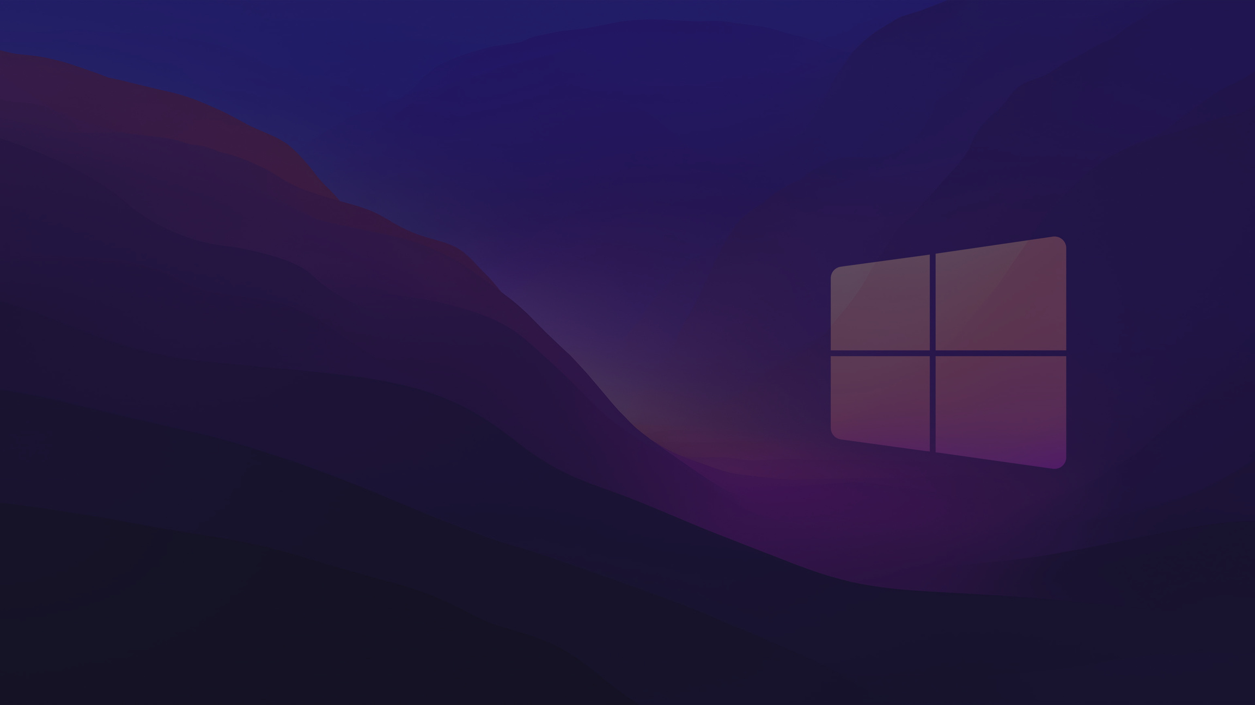
The Roadmap
INTRODUCTION
BENEFITS
WORKING
Definition, and Terminologies
Purpose of Virtualization
Variety of Virtualizations in Windows 11

Slide 4

What is Virtualization
Virtualization is the creation of a virtual -- rather than actual -- version of something
Virtualization uses Software
Virtualization uses software that simulates hardware functionality to create a virtual system
OS Virtualization
Virtualization
OS virtualization is the use of software to allow a piece of hardware to run multiple operating system images at the same time

Slide 5
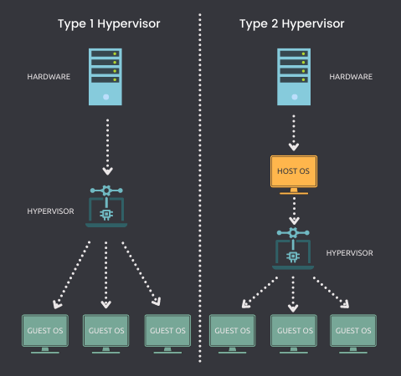
Hypervisor
Hypervisors take the physical resources and separate them so they can be utilized by the virtual environment. They can sit on top of an OS or they can be directly installed onto the hardware. The latter is how most enterprises virtualize their systems.
TYPE 1 - BARE METAL
TYPE 2 - HOSTED

Slide 6
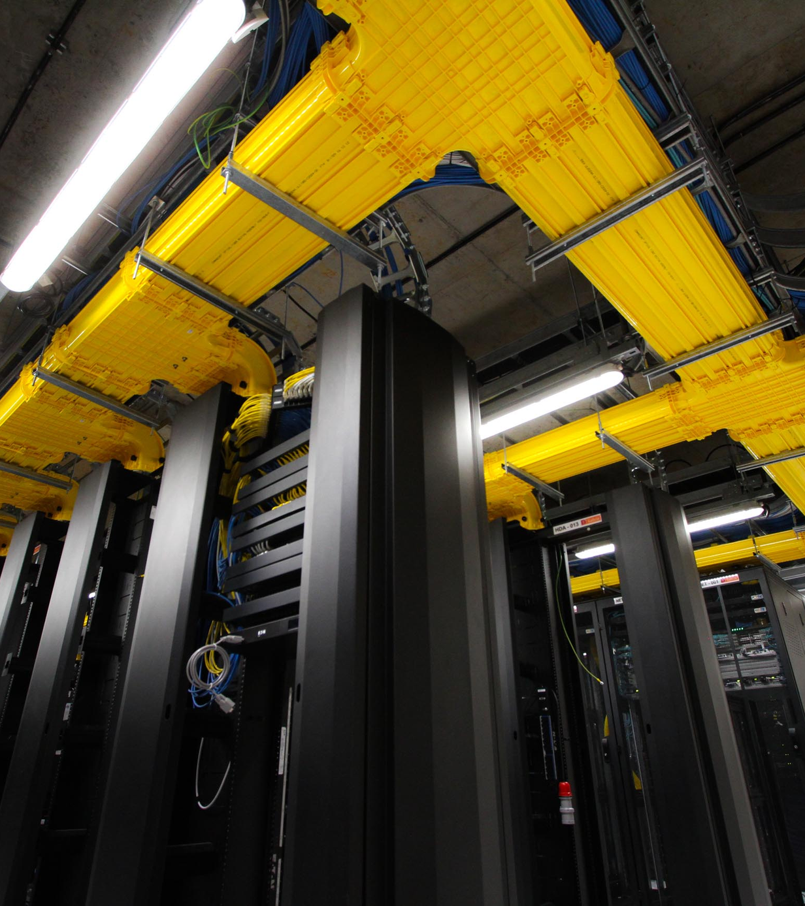

Applications
of Virtualization in detail, in the Modern Context, specially in the aspects of Windows 11 and Blockchain
TheMR

Slide 7
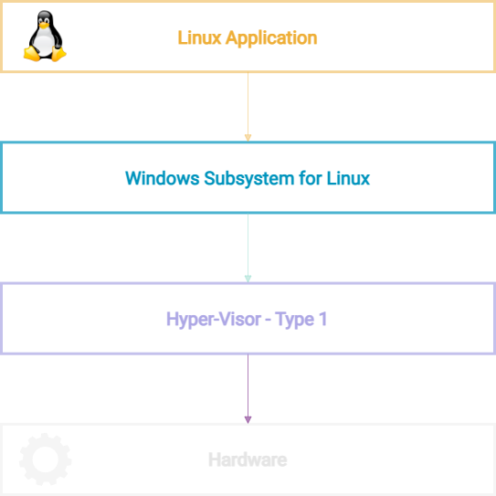
Windows Subsystem for Linux
Linux GUI Applications can now run Natively on Windows 11, using Real Linux Kernal, and consuming all the Native Resources, with Hyper-Visor Type 1

Slide 8
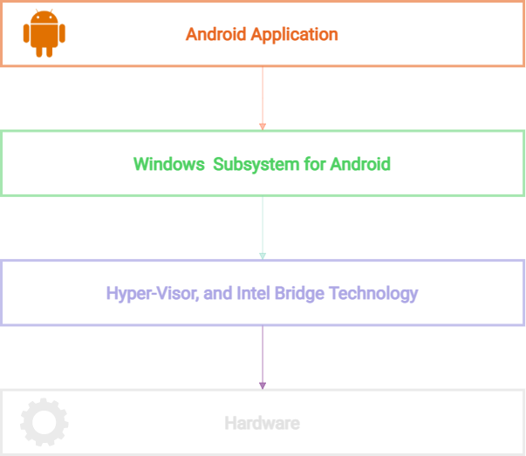
Windows Subsystem for Android
Android Packages (APKs) gets compiled into Native Windows Application during the installation, procedure of the package

Slide 9
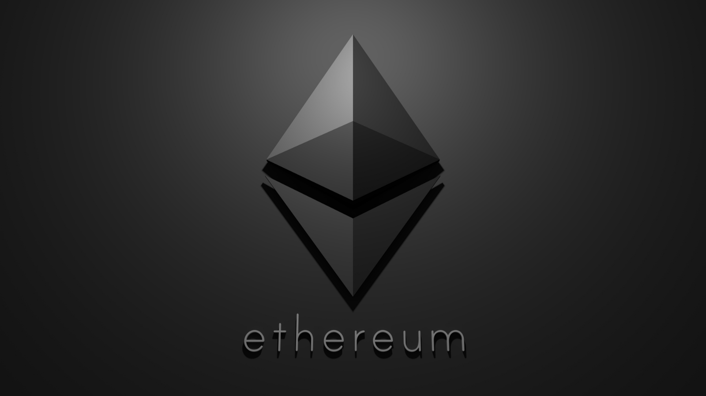


EVM Code
Etherium
Virtualization is needed to improve the portability of Etherium Network, as well as to make sure Nodes are separated from each other, and separated from their host
EVM Machine
EVM Node

Slide 10
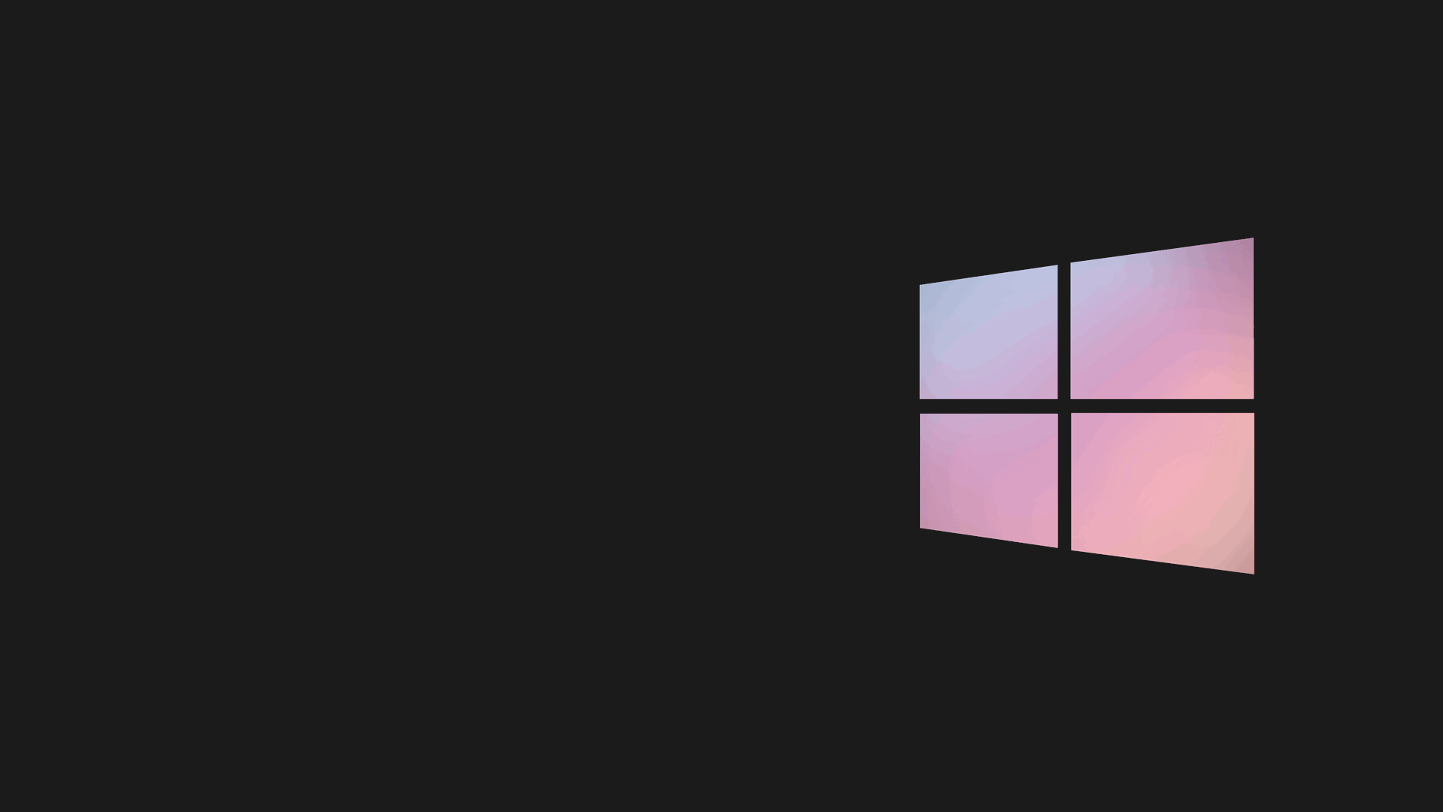
Reduced
Spending
Easier Backup
Business
Continuity
Efficient IT
Operations
Centralized
System
Testing
Purposes
BENEFITS

Slide 11


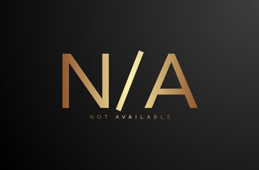
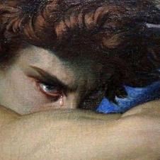
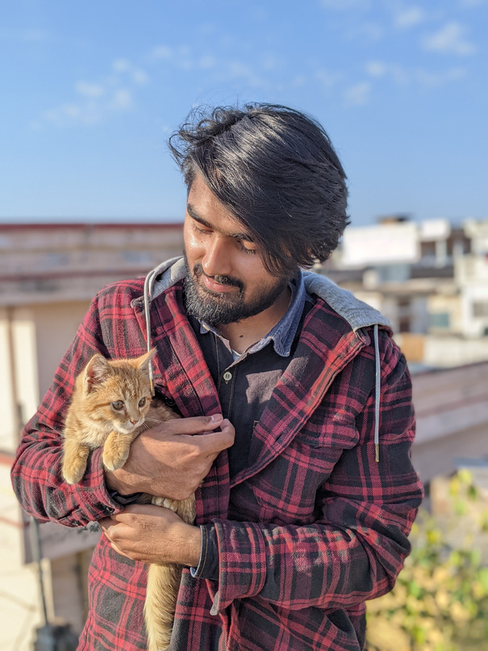
Muhamamd Ammar
@TheMR
If you only have a 'Hammer', everything will seem like a 'Nail'
Shaban Zaman
@RobinElliot
Stay humble and keep hustling
Harris Bin Abid
Thank You!
@Reaper9
That, which doesn't kill you, makes you stronger
Hopefully, you may have liked the Content!
Noman Shoaib
@RobinHood
Rise and Rise, until Lambs become Lions

